Slide 1
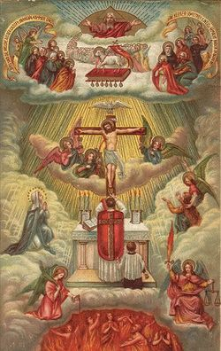
Confraternity for Holy Souls
Committed to a mission of hope and prayer
for the Church Penitent
On their journey to join the Church Triumphant
by the Church Militant

Slide 2
Pray to
St. Gertrude the Great
St. Gertrude showed "tender sympathy towards the souls in purgatory" and urged prayers for them.
In a vision, St. Gertrude was given a prayer which Our Lord told her would release 1,000 souls from purgatory every time it is said with love and devotion. Theologians tell us we may not be certain of the exact number, but the number 1,000 is biblical and symbolic for infinite. A “thousand” souls released means more than we can count, more than we dare to ask.

Slide 3
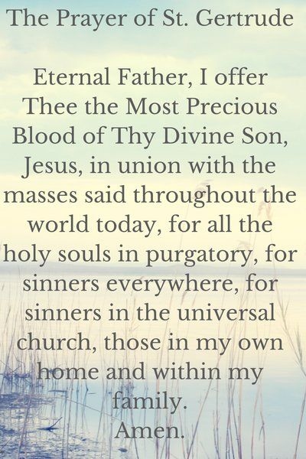

Slide 4
Gary Radomski – BIO Husband – 51 years Two adult children Five grandchildren U.S. Veteran Ford Motor Company – 30 years Coach – 55 years Athletic Director Bachelors Degree – Labor Relations – Wayne State Pastoral Ministry / Religious Studies - Madonna

Slide 5
(Cont.) Youth Group Ministry Pastoral Ministry at St. Sebastian’s Prayer Ministry Hospital Ministry Christian Service Ministry Director – Life Span - Wayne Co.

Slide 6
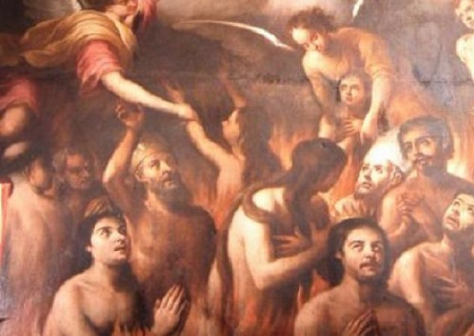
The souls in purgatory are silent voices that beg and implore our help.
They suffer day and night 24/7, 365 days a year, without any relief.
They are forever crying out to the living, “Have mercy on us, for we are lonely and poor.” We have a unique opportunity to be their voices and echo their cries.
If we could see the power of our sacrifices and the Masses offered for the Holy Souls, we would devote ourselves with such earnestness that the whole world would raise their eyes and take notice and would believe.

Slide 7
The Holy Souls in Purgatory cannot pray for themselves.
It is from us alone that the Holy Souls in Purgatory expect relief, help, and the termination of their sufferings.
We are their only resource.
We alone are their deliverers, for we alone can suffer with merit and release them.
Heaven encourages them; we deliver them.
Why We Should Pray for the Holy Souls in Purgatory
Our purgatory mission has just begun.
Pope John Paul II emphasized that the laity will be “missionaries” because contemporary man hears witnesses more easily than teachers.
“You will be able to set the world on fire! The hour of the laity has struck!”
(Nov. 26, 2000, Jubilee of the Apostolate of the Laity).

Slide 8
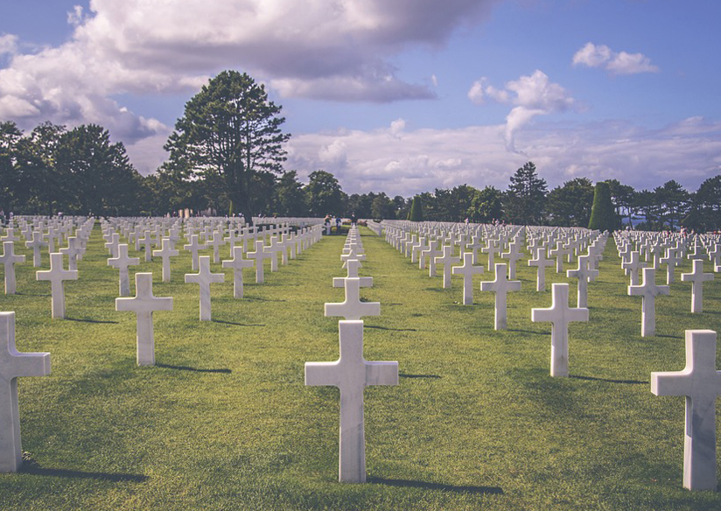
How to Help the Holy Souls:
Spring Devotions and Practices
Offer the gift of your indulgence for the Holy Souls at Divine Mercy Sunday (Second Sunday of Easter).
Become a “Divine Mercy Apostle” by distributing prayer cards and literature inviting all to take advantage of the extraordinary Divine Mercy graces.
Pray The Divine Mercy Novena (especially the one beginning on Good Friday) and the Chaplet of Mercy daily.
At weddings, include your deceased loved ones at the petitions of the Mass.
Plant a “prayer garden” in your yard in remembrance of the Holy Souls.
Recite Psalm 130, the official prayer of the Church for the Holy Souls.
When praying the Rosary in May, add an extra decade for the Holy Souls. (Saint Bernadette encouraged this style of Rosary!)

Slide 9
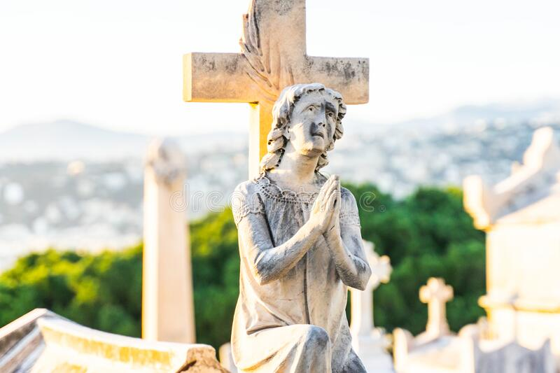
How to Help the Holy Souls:
Summer Devotions and Practices
Go on your own “purgatory pilgrimage” by visiting local parishes and designated shrines within your diocese. At each, pray for the Holy Souls.
Take a “prayer stroll” through your local cemetery to pray for all those buried there. Bring holy water to sprinkle on the graves. (It is one of the first sacramentals of the Church. Holy Water refreshes the Holy Souls.)
Visit the graves of your loved ones and clean sites in a spirit of prayer and penance.
Pray the Eternal Rest Prayer on your rosary beads. (Eternal rest grant unto them, O Lord, and let perpetual light shine upon them. May their souls and all the souls of the faithful departed, through the mercy of God, rest in peace. Amen.)
Pray the Seven Penitential Psalms (Seven psalms that express sorrow for one’s sins: 6, 32, 38, 51, 102, 130, and 143).

Slide 10
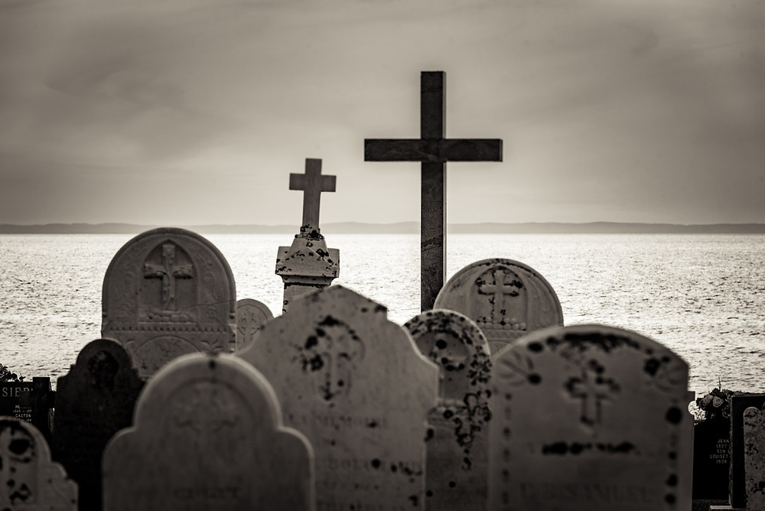
How to Help the Holy Souls:
Fall Devotions and Practices
An indulgence is granted the Christian faithful who devoutly visit a cemetery and pray, even if only mentally,
for the dead. This indulgence is applicable only to the souls in purgatory. This indulgence is a plenary one from
Nov. 1 through Nov. 8 and can be gained on each one of these days.
Double up on prayers and sacrifices for departed loved ones and friends during this powerful season of the dead
(the November remembrance).
Visit cemeteries with your children. Teach youth to pray the Eternal Rest Prayer. Again, sprinkle holy water
on the graves in the cemetery.
Light blessed candles. The burning of a candle is a sign of our prayer, a bright, silent intercessor for the Holy Souls.
Excerpted from Praying with the Saints for the Holy Souls in Purgatory, by Susan Tassone
Susan Tassone has long been a passionate champion for the holy souls in purgatory and is recognized as leading a worldwide “purgatory movement.”.

Slide 11
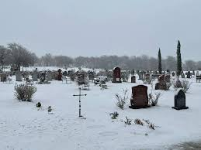
How to Help the Holy Souls: Winter Devotions and Practices
Mark your calendar throughout the year for special dates as a reminder to pray for your dearly departed loved ones.
Offer Masses year-round for living and deceased family members and friends.
Create a family tree and offer Gregorian Masses (30 Masses for a departed soul) for your parents, grandparents, etc., to the fourth generation. This is very potent and brings many graces.
Pray for 15 minutes before and after Mass in thanksgiving to Jesus and for all your ancestors who have gone before you. We would not be here if it were not for the sacrifices they made for us.
Fast on Fridays in honor of our Lord’s Passion. Implement different kinds of fasting such as “fasting” from gossiping, giving in to idle curiosity, complaining, criticizing, watching TV, drinking alcohol, smoking, or other activities that give one pleasure.

Slide 12
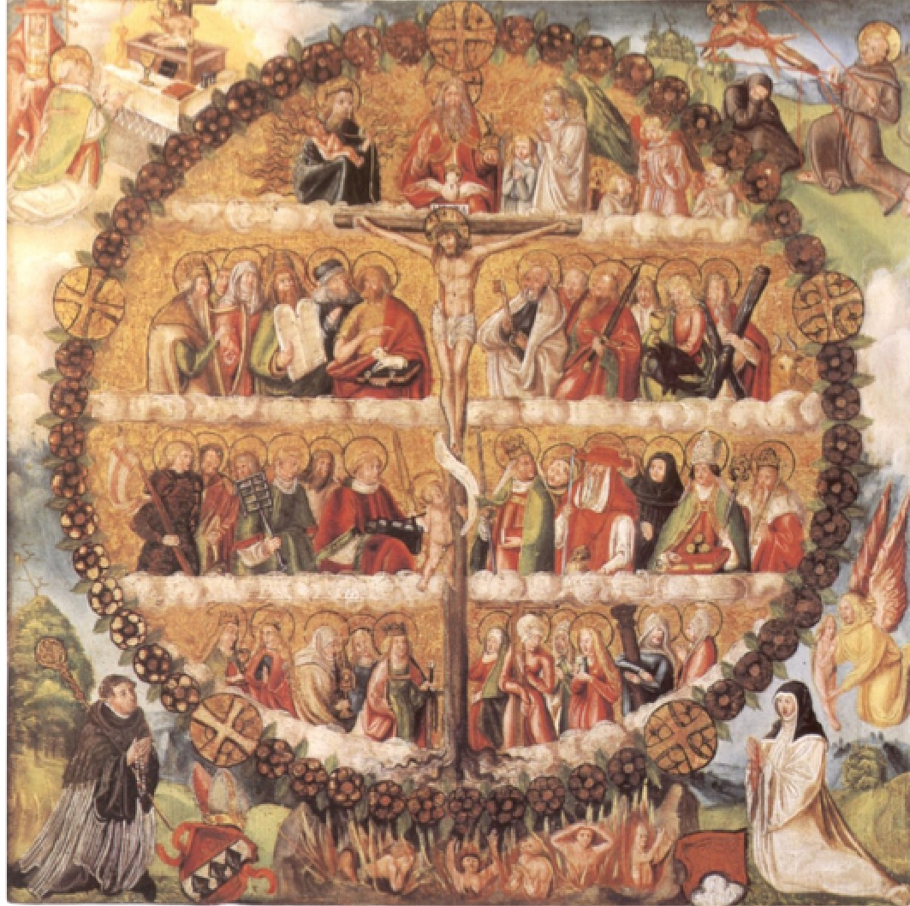
How to Help the Holy Souls:
Pray to the Saints
Saints have encouraged us to pray for the Holy Souls.

Slide 13
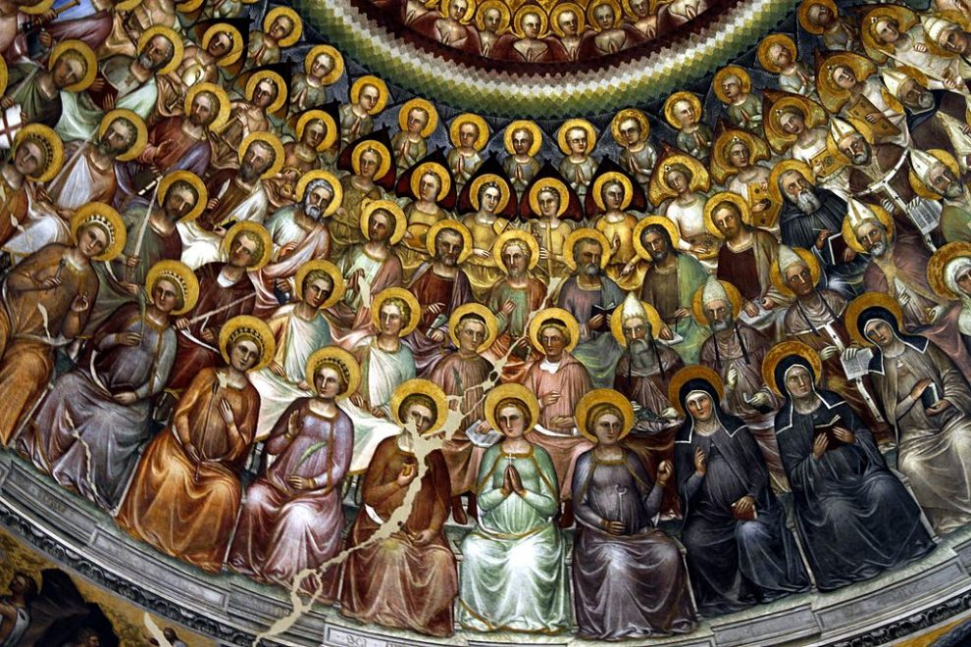
What have we learned from the saints?
We know there is a profound communion between the living and the dead.
We know there are no borders between us and those who have gone before us.
We know the power and great efficacy of our intercessory prayers.

Slide 14
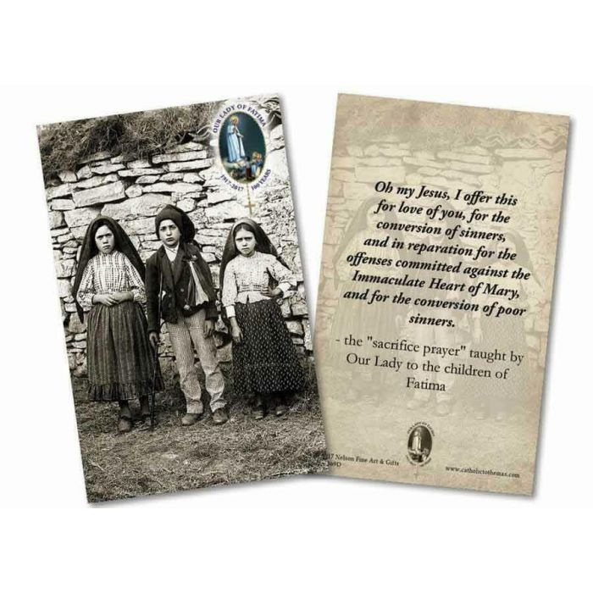
Mary Asked Us to Pray for the Holy Souls: The Sacrifice Prayer

Slide 15
Days most souls go to heaven
Christmas
All Hallows Tide (Nov 1 – 2)
Good Friday
The Feast of the Assumption
The Feast of the Ascension

Slide 16
Prayers for Specific People
Bring all those you love who have gone before you before the Lord in the Blessed Sacrament. Jesus loves these souls and He wants us to pray and intercede on their behalf.
ACCLAMATIONS (Acclamations are an ancient form of prayer. They were used as ejaculatory prayers in the liturgy and inscribed on tombs.)
Jesus Christ, the Lion of the tribe of Judah, the root of David, has conquered. Alleluia!
Have mercy on the souls of (names).
Amen.
O compassionate Father, Son, and Holy Spirit, have mercy on the souls of (names). Give them the rest. You keep for your saints.
Amen.
FOR DECEASED PARENT(S)
Dear God, Father of our Savior, incline Your ear as I pray for my (father and/or mother), (mention name[s]), whom You have called from this life.
In Your most tender mercy, recall (his/her/their) kindness, generosity,
love, and devotion to duty.
May (he/she/ they) attain that Beatific Vision which You have reserved for those who love You and do Your will.
Amen.

Slide 17
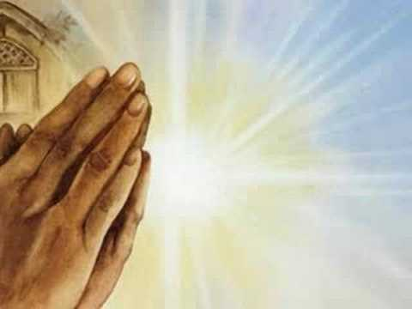
Prayers for Specific People
FOR A HUSBAND OR WIFE
O Lord of mercy, I pray that You will keep in your care the soul of (name),
who was my soul mate, companion, and dearest friend in this life.
Grant my beloved Your assurance of final salvation in the company of the saints.
Amen
FOR LOVED ONES AND FRIENDS
O most loving and gracious Savior,
I implore Your mercy on behalf of the souls of those very dear to me: (names).
My God, pour forth Your blessings and Your mercies upon all persons
and upon all souls in purgatory
for whom, by reason of charity, gratitude, and friendship,
I am bound or desire to pray.
May they now find relief from their temporary suffering through the intercession of this prayer and the benevolence of the saints who already are present to you.
Amen.
FOR THE NEWBORN, THE UNBORN, OR THE MISCARRIED
(Name), our (son or daughter), ours for a little while, pray for us.
Amen.
From Prayers, Promises, and Devotions for the Holy Souls in Purgatory by Susan Tassone

Slide 18
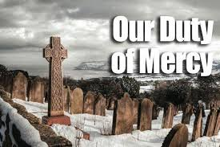
How Can the AOD Confraternity Help the Holy Souls
We can all do something to help the Church Penitent on their journey to joining the Church Triumphant.
It is an important act of mercy which Mary has asked us to do. For starters, we can:
Create a Monthly Bulletin Focus: share information on Purgatory, how to avoid it, and how to help the Holy Souls
Distribute Commitment Calendars to anyone interested in doing something everyday to help the Holy Souls
Share Purgatory Prayer pamphlets and books on Purgatory with parishioners
Begin a St. Padre Purgatory Box to pray for a different group of departed souls each day
Offer Masses for the Holy Souls every month
Develop seasonal practices for our Church to participate in
Sponsor Monthly Purgatory Prayer meetings for all who wish to attend. We will pray for all the deceased family and friends of parishioners from the prior month.
Pray for the deceased at the request of the family or friends.

Slide 19
SUGGESTIONS OF ORGANIZING A CONFRATERNITY IN OUR PARISH FAMILY
THE MISSION OF THE CONFRATERNITY FOR HOLY SOULS OF THE ARCHDIOCESE OF DETROIT
Every soul should have the opportunity to enter heaven. This is the basic message of the Gospel” (Mt 28:17-20; Col 3:1-3).
The mission and intention are to pray for souls in purgatory as a vocation and mission of mercy to relieve and gain release for suffering souls in Purgatory who can no longer help themselves.
The intention of the Confraternity for Holy Souls is to help the faithful:
Know and understand how to pray for the souls in purgatory
Know and understand the Church’s teaching on indulgences
The Four Last Things (Death, Judgment, Heaven, Hell)
Another important aspect of the Confraternity is to guide the faithful in offering prayers, Masses, the exercise of indulgences, and understanding the doctrine of suffering associated with souls in purgatory and incomplete suffering.

Slide 20
WHAT MAKES THIS CONFRATERNITY SPECIAL?
As children of God, who among us would not rush to the aid of a hurting family member? Yet too often, the axiom “buried and forgotten” is proven true of the departed. The Archdiocese Confraternity is making a fresh effort to correct such an attitude by embracing prayer for the faithful departed as a work of mercy that has been encouraged by our Lord Himself through revelations to saints throughout the ages.
Our Confraternity for Holy Souls exists in the heart of our Archbishop; his Unleash the Gospel Letter on June 3, 2017, and Evangelization of the church.
WHAT IS THE ORIGIN OF PURGATORY CONFRATERNITIES
In the Middle Ages, purgatorial societies were very popular, and entire religious orders were devoted to relieving the suffering of the poor souls in Purgatory. But with the Protestant Reformation and the attack of the reformers on the doctrine of Purgatory, interest in the purgatorial groups began to fade.
In recent years, however, some dioceses and parishes have begun to revive the purgatorial society.

Slide 21
a) Purgatory is not a third place along with Heaven and Hell, nor is it a second chance.
b) Purgatory is like the Holy Hospital of Heaven
c) Souls in Purgatory have been saved as much as the souls in Heaven
d) Think of sin as a self-inflicted wound in your life.
e) Understand the last Four Things: Death, Judgment, Hell, Heaven
f) Know this is Evangelization, a Vocation and Lay Ministry
g) Ask the Blessed Mother to choose an unknown soul for you to pray for and lovingly sprinkle Holy Water, in faith and trust, for cleansing
WHEN TALKING TO INTERESTED MEMBERS ABOUT PURGATORY, IT’S IMPORTANT THAT THEY KNOW:

Slide 22
WHEN TALKING TO INTERESTED MEMBERS ABOUT PURGATORY, IT’S IMPORTANT THAT THEY KNOW: (Cont)
h) Light their darkness, as an act of love, by burning a blessed candle for them
i) Liturgical prayers like Psalm 129 (The Official prayer for Holy Souls in Purgatory, Eternal Rest Prayer, Pray the Office of the Dead or Vespers, the liturgical hours of the Church, Prayers from the Roman Missal for the Souls in Purgatory
j) Visit a Cemetery and pick out a number of gravestones and say some prayers for their soul
k) November 1st – 8th, a plenary indulgence can be obtained for the Faithful Departed souls by devoutly visiting a cemetery and praying for the dead. Use the tombstone as a kneeler and pray the Rosary for your loved ones.

Slide 23
ORGANIZATIONAL SUGGESTIONS FOR YOUR GROUP
Need leadership support
Educate the faithful on the urgent need to assist the Holy Souls
By becoming a Member, You make a deeper commitment to the welfare of Holy Souls
You arouse a great zeal for accomplishing corporal and spiritual deeds of mercy
Use your social media to inform and promote the Website
Give them a reason to get involved
Make a connection
Most Important, make a personal invite to individuals you know that may be interested.
Approach Parish Groups, First Friday, Rosary, Funeral, Knights, Women and Men’s Prayer Groups, Alter Society, Gospel of Life, Family Life, Parish Ministry
Church Bulletin Announcements and Announcements in church

Slide 24
ORGANIZATIONAL SUGGESTIONS FOR YOUR GROUP (Cont.)
Informational Meeting and Planning in Parish Families I am available to help.
Informational Meeting to each Parish
Simple Sign-Up System
Use promotional Resources
Church Bulletin Announcements
Announcements in church
Informational Meeting and Planning in Parish Families I am available to help.
Informational Meeting to each Parish
Simple Sign-Up System
Use promotional Resources

Slide 25
MY COMMITMENT TO HOLY SOULS IN PURGATORY
Go to Mass and receive the Eucharist
Pray the Chaplet of the Divine Mercy
Offer an act of sufferance
Pray the Rosary with one extra decade for Holy Souls
Pray to a special saint/blessed of Purgatory
Go to Eucharist Adoration for at least ½ hour
Pray a special prayer for the deceased
I will offer a Mass for Holy Souls in the month of _____

Slide 26
Ways to help the Holy Souls in Purgatory
The best way to help is to have the Holy Sacrifice of the Mass offered up for them
The Stations of the Cross
Pray the Holy Rosary
Gain indulgences for them
Offer up pains, self-denials and sufferings for their relief
Pray, offer up works of mercy and practice virtues
Ask the Blessed Mother to choose an unknown soul for you and sprinkle Holy Water
Light their darkness by burning a blessed candle for them
Liturgical prayers like Psalm 129 (The Official prayer for Holy Souls in Purgatory, Eternal Rest Prayer, Pray the Office of the Dead or Vespers, the liturgical hours of the Church, Prayers from the Roman Missal for the Souls in Purgatory
Visit a Cemetery and pick out a number of gravestones and say some prayers for their soul
November 1st – 8th, a plenary indulgence can be obtained for the Faithful Departed souls

Slide 27
PRAYER PACK
A Prayer addressed to the Poor Souls in Purgatory (M)*
A Prayer For Deceased Priests, Bishops and Popes in Purgatory (M)*
HEROIC ACT OF CHARITY FOR THE HOLY SOULS IN PURGATORY (M)*
HOLY HOUR OPENING PRAYER (M)*
SUGGESTED HOLY HOUR ORDER FOR PRAYER (M)*
HOLY HOUR CLOSING PRAYER (M)*
PRAYER FOR A UNKNOWN SOUL (M)*
Prayer to Our Lady Queen of Purgatory (M)*
Litany for Poor Souls in Purgatory (M)
All Souls Novena (M)
Pray for the Poor Souls in Purgatory Card (M)
Daily Pilgrimage to Purgatory (M)
Explanation of the St. Gertrude Prayer (AM)
Saint Gertrude Prayer(AM)
Purgatory a Guide (AM)
Heaven, Hell, and Purgatory from the Diary of Saint Faustina (AM
Prayers for the Deceased for every day of the Week (AM)
An Introduction to Indulgences (AM)
How to Gain A Plenary Indulgence(AM)
Prayers with Partial Indulgences (AM)
The Four Daily Plenary Indulgences(AM)
The Rosary of the Seven Sorrows (AM)
Purgatory Fulfillment of God’s Justice or Fruit of His Mercy (AM)
Teaching Kids to Pray for the Souls in Purgatory (AM)
(AM) = Can be purchased in a pack from Marian Press Stockbridge MA 01263 or ShopMercy.org
(M) = Can be reprinted and custom for your parish or from the Archdiocese (8 ½” x 11”)

Slide 28
Apostles of Purgatory Commitment Card
Each person in the ministry will offer an action to assist the Holy Souls each day of the week. For example:
To help the Holy Souls, I will… | On…
Go to Mass and receive the Eucharist | Sunday
Pray the Divine Mercy chaplet | Monday
Offer an act of sufferance | Tuesday
Pray the Rosary with one extra decade for the Holy Souls | Wednesday
Pray to a special saint of Purgatory (Pray to a different saint each week) | Thursday
Go to Eucharist Adoration for at least ½ hour | Friday
Pray a special prayer for the deceased | Saturday
Annual Commitment
I will offer a Mass for the intention of the Holy Souls in the month of … | March

Slide 29
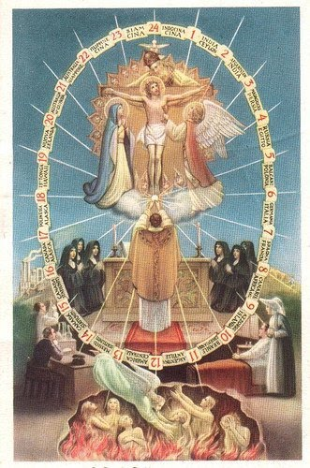
Please contact Radomski.gary@aod.org or at (313) 310-7005 for more information on becoming an Apostle of Purgatory or if you have a Holy Soul you would like us to pray for.

